Slide 1
Board of Governors
October 23, 2024

Slide 2
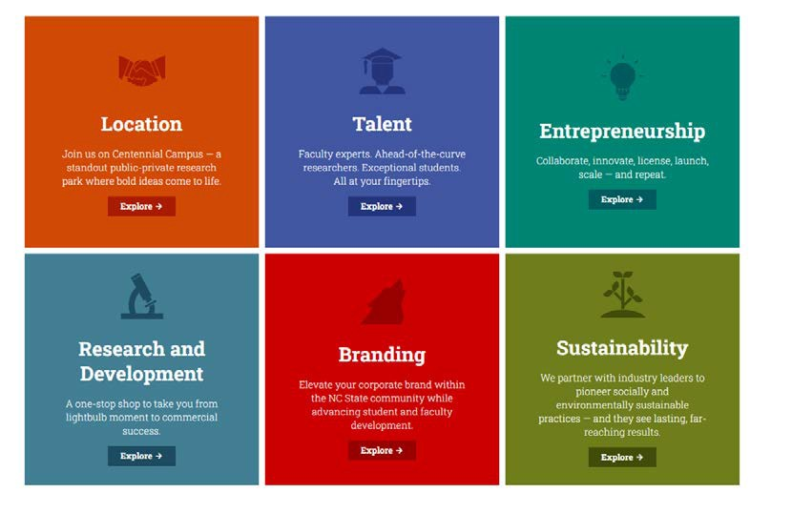
R1 Research universities are a rich source of talent, expertise, R&D resources!
Navigating through them to find the right connection can be complex.
Engage with R1 faculty expertise in areas as diverse as artificial intelligence and metabolic disorders.
Connect with highly-qualified students for internships, co-ops and full-time hires.
Launch businesses built around the licensing of Wayne State technology, science and programs.
Access to state-of-the-art testing services and lab equipment to develop new technologies.
Locate in and around our Midtown Detroit campus

Slide 3
The entry point for corporations to tap into the knowledge, talent and resources at Wayne State University.
Launching in Fall 2024, WSU OPEN is a new initiative advancing Wayne State’s Prosperity Agenda pillar to “Fuel Innovation for Our Competitiveness” by optimizing and amplifying external partnerships.
OPEN provides the same knowledgeable, creative and quick-to-respond concierge-quality service to existing and prospective corporate partners that it provides to internal colleagues. This results in optimized relationships with both internal and external stakeholders that inspires the pursuit of deeper and more productive ways to advance our mission.

Slide 4
2025
AND BEY OND
Initiatives, events and research are resourced with new funders and by deepening
relationships with existing Implement learnings from surveys, focus groups and advisory
council recommendations
A CADEMIC YEAR 2025
Communicate stories of success and opportunities for improvement Establish metrics for success and transparent reporting Announce OPEN, share strategy, gather feedback, iterate
Recruit for key leadership positions, increase accountability for current team
MAR CH – A UGUST
Envisioned a new structure, defined roles and responsibilities Transitioned team, on-boarded, set new tone for unparalleled customer service and
prospect qualification to include event sponsors
Began normalizing meeting cadence/expectations with internal stakeholders

Slide 5
MAY 2024 – A UGUST 2024- A C C O MPLISHMENTS
Realigned team to new responsibilities including setting targets for # of solicitations, faculty engagement, concept paper drafts, databases usage, customer service
Implemented an open-door policy and proactively communicated during listening sessions with academic partners Mapped external stakeholder journey, identified redundancies, gaps, opportunities and database needs
Defined working list of metrics
Developed on-going cadence for work with Advancement Services to track progress Made 12 referrals across campus
Helped build/track interdisciplinary coalitions
METRIC | GO AL | OUTPUT
Engage faculty / team members | 60 | 118 (some engaged multiple times)
Identify concepts / funding opportunities | 12 | 37
Concepts outlined (one-pager) | 8 | 8
Funders/ prospects in FPM correctly | Y/N | 95% correct
WSU OPEN meetings / visits / engagements | 90 | 50 13 companies 18 different projects 19 internal departments
24 hour response on inquiries | Y/N | Yes
All referrals and follow-up made | Y/N | Yes; 12

Slide 6
MILESTONES FOR THIS PERIOD
Solicitation of more than $50,000 made as a result of faculty partnerships
Plan for how to operationalize learnings from focus groups created
Qualification efforts have increased to represent at least 20% of portfolio
Net Promoter Score established as way to validate customer service value
Engaged 118 faculty
Made 38 solicitations Identified 37 fundable ideas Engaged 50 companies Began disciplined tracking Completed on-boarding for new team
M AY 2024
DE CEMBER 2024
A UGUST 2025
SEPTEMBER 2024
APRIL 2025
Corporate Engagement located in Division of Entrepreneurship and Economic Development
36 solicitions made Sept.-Dec. Hiring complete
WSU OPEN launched with webpage and announcement Internal survey issued Faculty toolkit offered
Data hygiene and 90-day sprints normalized Feedback from user on webpage incorporated
Presentation at NACRO made NPS above 80
2 cross-campus coalitions built and federal awards solicited
200 businesses engaged
96 meetings with faculty completed 240 solicitations made
$7.5 million in revenue generated Quick pace of response
(24 hours from external inquiry) met
4 stories of success in Today @ Wayne 4 visits to campus by corporate leadership
One sponsored research project secured
3 meaningful / funded internship programs supported
New job descriptions implemented
On-boarding complete 90-day plans implemented

Slide 7
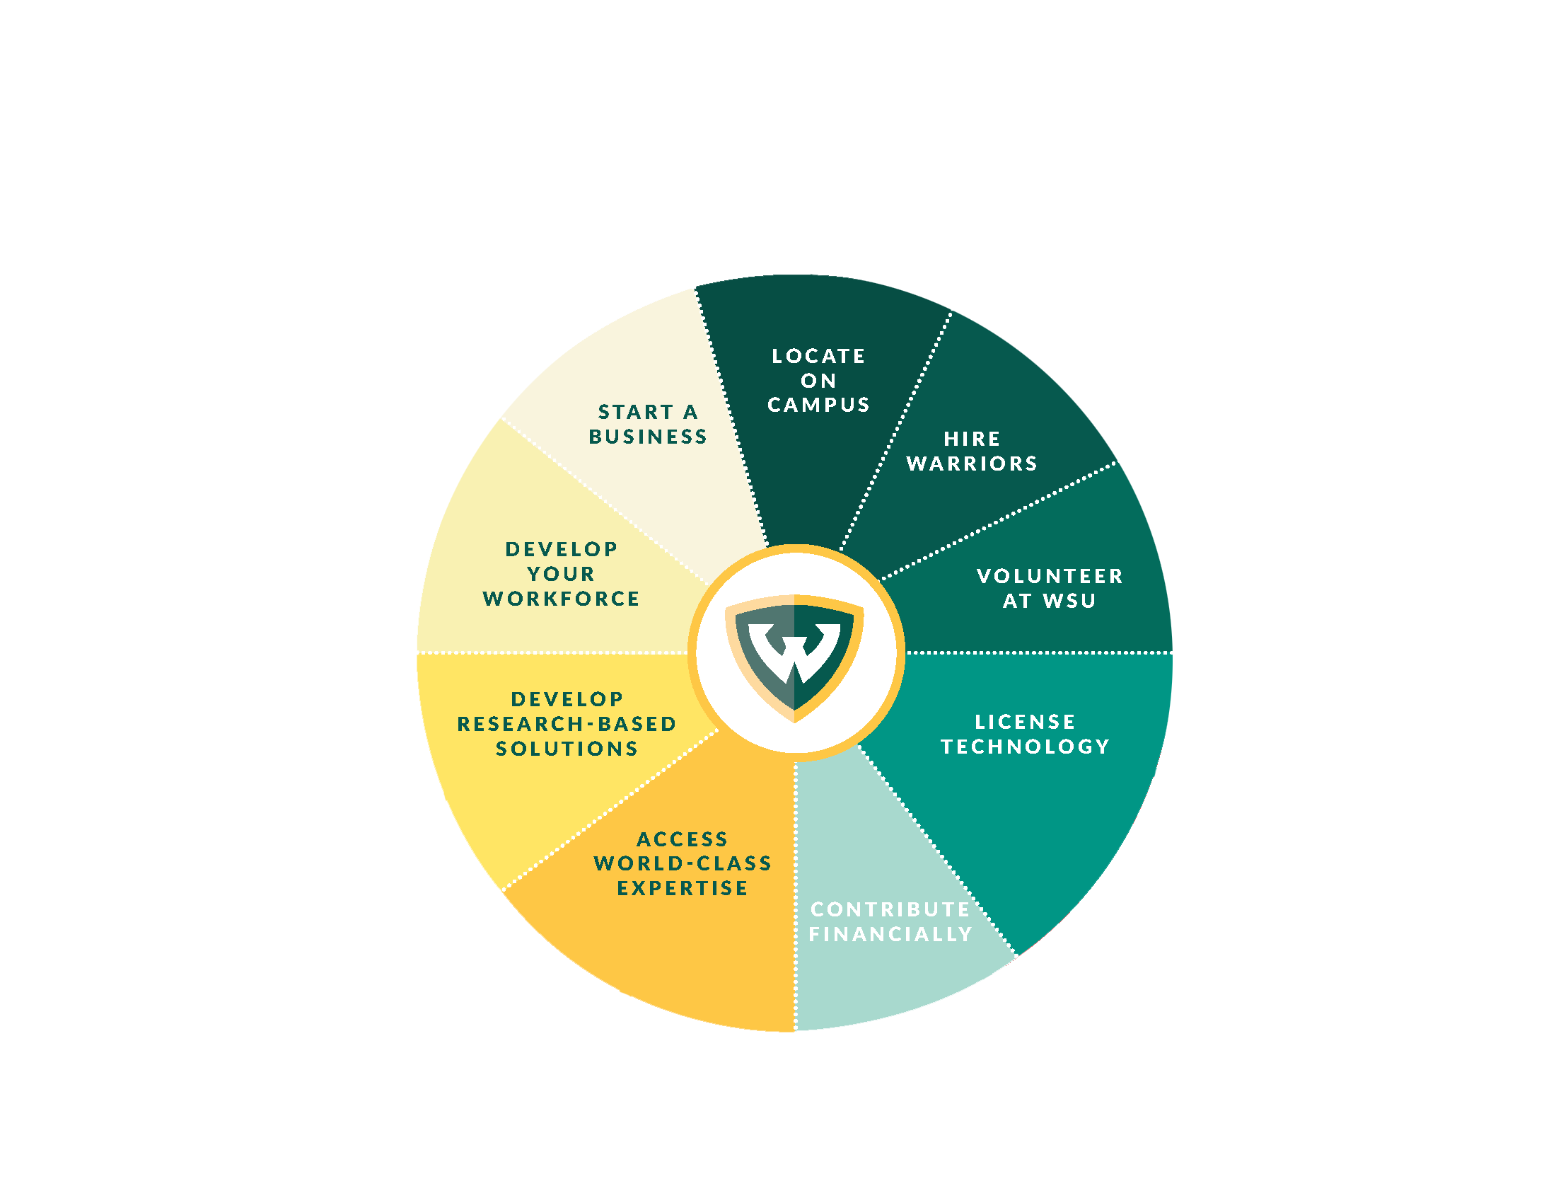
VARIOUS WAY S T O ENGAGE:

Slide 8
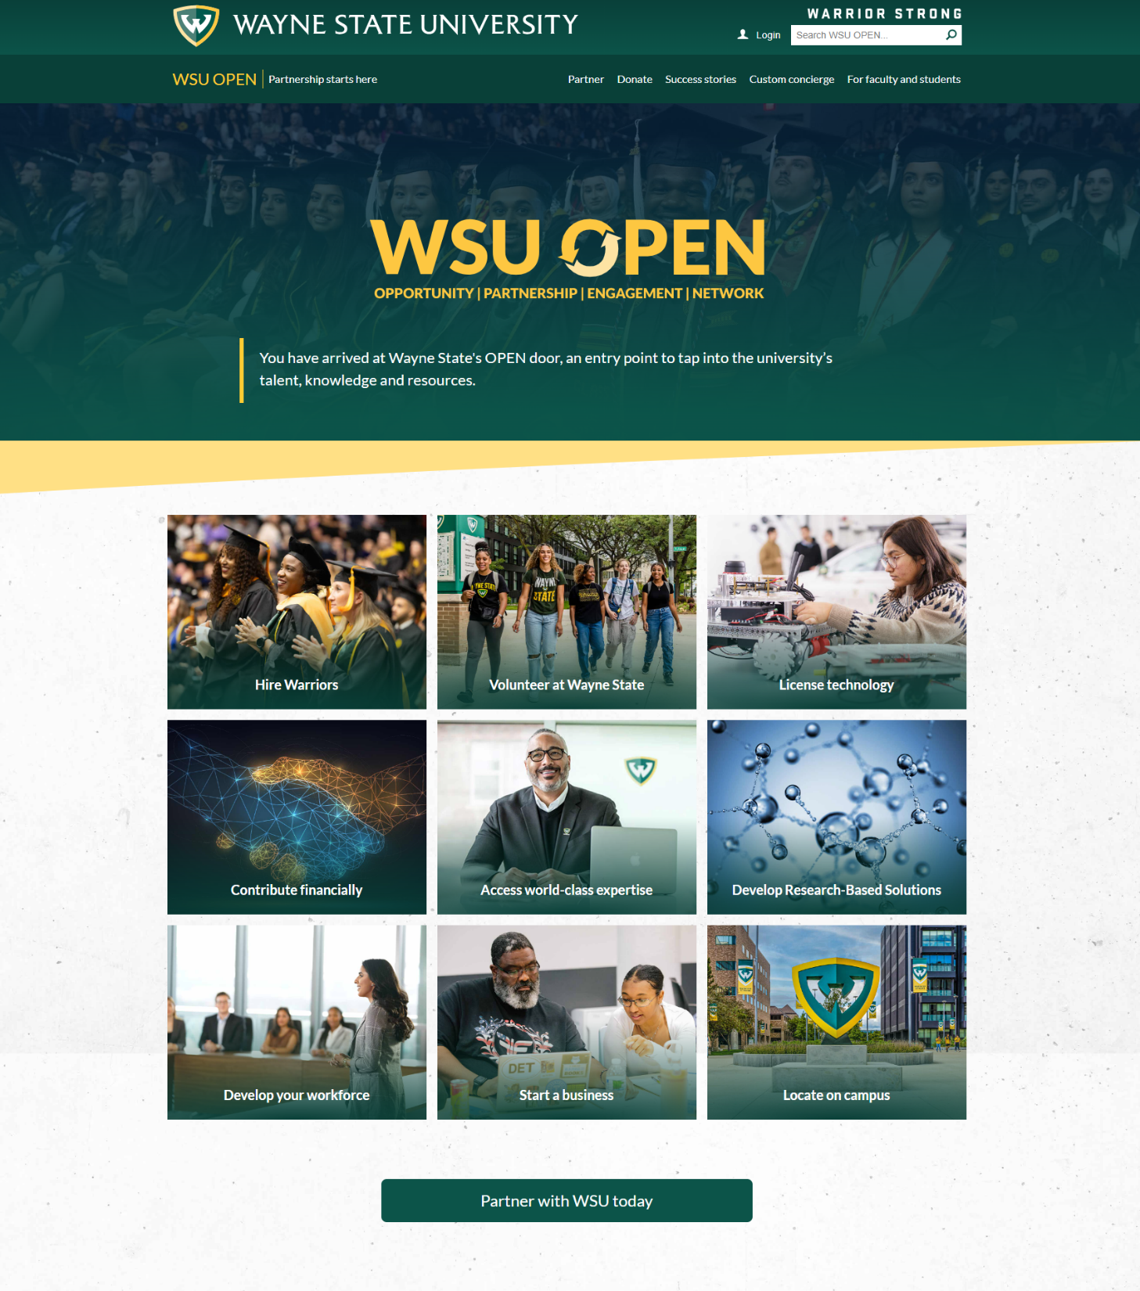
•
•
•
•
•
,I
•
•
•
•
•
•
•
•
•
•
•
•
•
•
•
•
•
•
. .
•
•
•
•
•
..
•
•
•
•
•
'
I
•
•
•
•
•
•
•
•
•
•
•
•
•
•
•
•
•
•

Slide 9
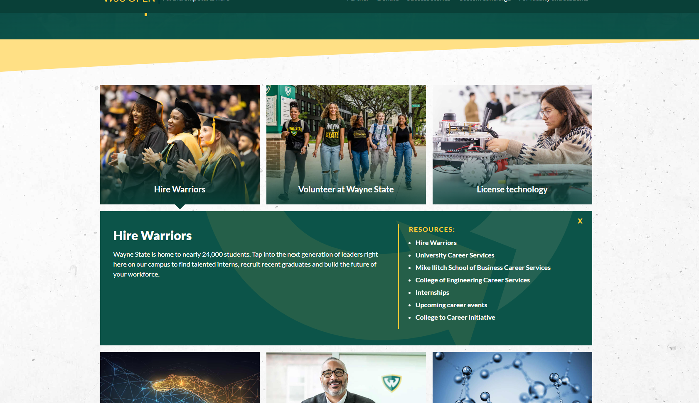
•
•
•
•
•
,I
•
•
•
•
•
•
•
•
•
•
•
•
•
•
•
•
•
•
. .
•
•
•
•
•
..
•
•
•
•
•
'
I
•
•
•
•
•
•
•
•
•
•
•
•
•
•
•
•
•
•

Slide 10
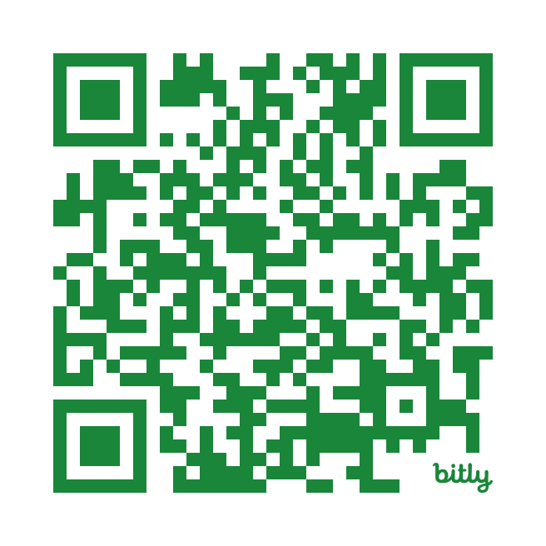
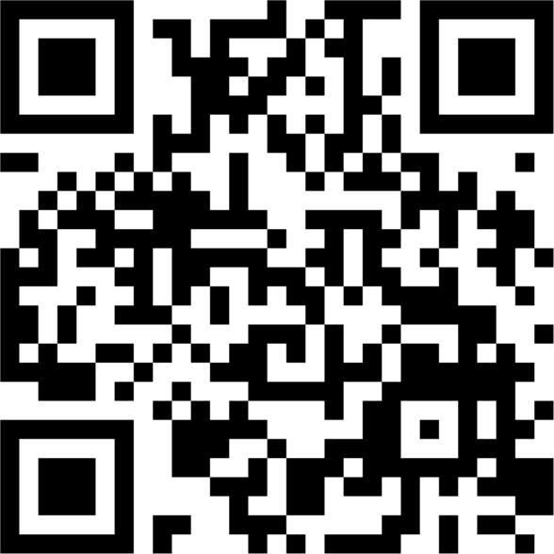
OPEN@ WAYNE.EDU

Slide 11
200
BUSINESSES ENGAGED
LESS THAN
24
HOURS TO RESPOND
TO EXTERNAL INQUIRY
SECURE 1 CORPORATE- SPONSORED RESEARCH PROJECT.
96
MEETINGS WITH
FACULTY
240
SOLICITATIONS
MADE
4
STORIES OF SUCCESS
COMMUNICATED
2
COALITIONS BUILT TO PURSUE FEDERAL AWARDS
1
VISIT PER QUARTER
FROM CORPORATE LEADERS TO CAMPUS
$7.5 mm REVENUE GENERATED
ONE WEEK
BETWEEN EXTERNAL
INQUIRY AND INTERNAL REFERRAL
3
MEANINGFUL / FUNDED
INTERNSHIP PROGRAMS

Slide 12
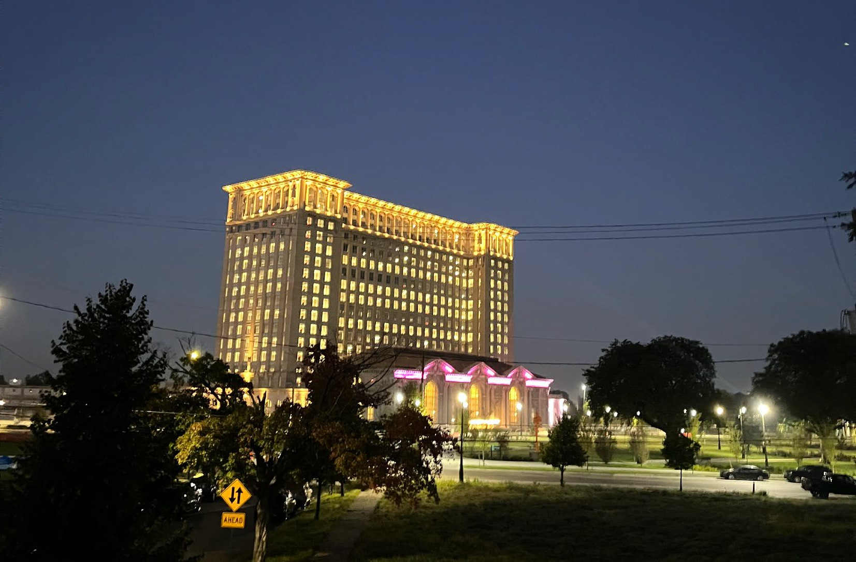
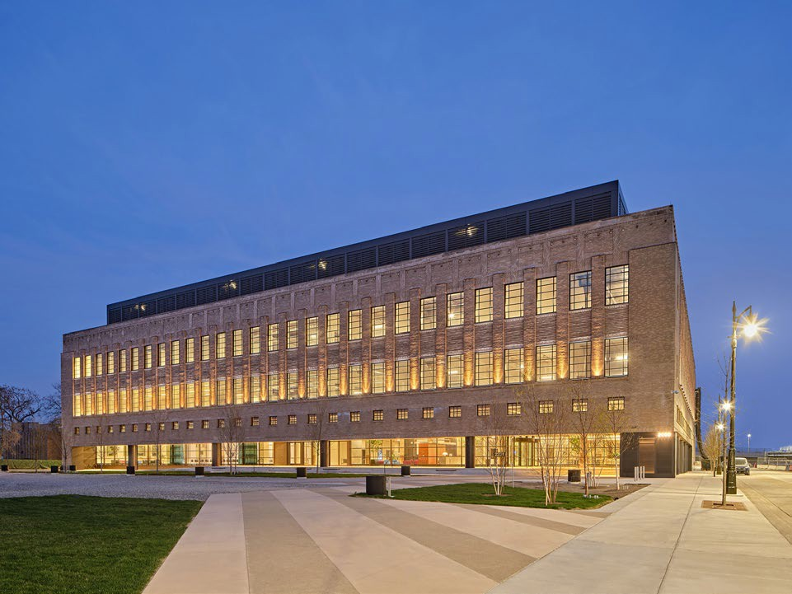
Michigan Central is advancing technologies and programs that address some of the most pressing challenges facing humanity today
Brooklyn-based Newlab is their current operational partner managing the space,
startups and activations

Slide 13
A partner-first approach resulted in an MOU between Michigan Central and WSU that identified 29 specific projects for collaboration in four strategic areas:
Pre-K, Secondary and Post-Secondary Education Pipeline
Support and growth for the innovation economy in Detroit
Upskilling, Reskilling and Adult learning
Co-creation of ecosystem solutions

Slide 14
Pre-K, Secondary and Post-Secondary Education Pipeline
Created the Michigan Mobility Fellowship Program whereby an WSU employee-on-loan is embedded within the Michigan Central Skills team until October 31, 2025, with an option for extension
Expand dual enrollment programs with mobility career pathways focusing on credit for prior learning
Leverage the Anderson Ventures Institute and the Belinsky Entrepreneurship Learning Lab to expose college students to real-world learning opportunities and co-location with industry
Develop industry-backed common curricula as pipeline to mobility/engineering programs

Slide 15
Support and growth for the innovation economy in Detroit
Develop short-term and long-term funding proposals to address the lack of funding provided by the state’s SmartZone program
Leverage the Mobility Accelerator Innovation Network (MAIN) to position Entrepreneurs-in-Residence to provide technical assistance to founders, pitch competitions, access to idea-stage mobility founders and a pipeline to Newlab members.
Offer students and mentors space to explore real-world learning experiences via WSU’s Engineering Clinic
Orchestrate opportunities with students in Warrior Ventures to meet founders with the goal to increase their knowledge of entrepreneurial and funding opportunities.

Slide 16
Upskilling, Reskilling and Adult learning
Develop non-traditional learning opportunities for workers of all experience levels
Leverage existing upskilling programs (currently short courses with online, self-paced learning) or develop new
Develop certification programs for adult learners for credit towards a degree.
Develop credit for prior learning opportunities for adult education programs that are within the Michigan Central service provision mix

Slide 17
Co-creation of innovative solutions
Create workshops on relevant topics that can support advancement of the Michigan Central ecosystem of founders, companies and partners (e.g. UX and human centered design, Artificial Intelligence, etc.)
Co-apply for grant opportunities (e.g. NSF, Federal NOFA/NOFO, etc.) to sponsor industry-relevant research opportunities in partnership with Michigan Central, as well as public and corporate partners.
Collaborate on the ways that a new Minor in Entrepreneurship & Innovation can support the career pathways at Ford and Michigan Central
Identify and deploy research faculty to support industry challenges as part of faculty-in-residence and co- research partnerships

Slide 18
What we envision Wayne State’s presence to look like inside:

